Slide 1
October 23, 2020. 2 pm ET
Dealing with DSARs
Heather Federman
BigID
Rachel Glasser
Wunderman Thompson
Heather Egan Sussman
Orrick, Herrington & Sutcliffe LLP

Slide 2
Speaker
Heather Federman
VP of Privacy & Policy
BigID
Heather Federman is the Vice President of Privacy & Policy at BigID, where she manages and leads initiatives related to privacy evangelism, product innovation, internal compliance and industry collaboration.
Prior to BigID, Heath was the Director of Privacy & Data Risk at Macy’s Inc., managing policies, programs, communications and training. Heather was also the Senior Privacy Manager at American Express Co., focusing on AMEX’s global brand, marketing and digital partnerships. She previously served as a Legal & Policy Fellow for the Future of Privacy Forum and as the Public Policy Director for the Online Trust Alliance, working with companies, regulators and advocates to further FPF’s mission in advancing responsible data practices and OTA’s mission in establishing trust in the online ecosystem.
Notes:
TOM WILL INTRODUCE

Slide 3
Speaker
Rachel Glasser
Chief Privacy Officer
Wunderman Thompson
As the Global Chief Privacy Officer for Wunderman Thompson, Rachel Glasser oversees all privacy and data protection matters for Wunderman Thompson and Wunderman Thompson Data. She is responsible for overall compliance design, as well as data privacy laws and regulations, particularly in regard to the General Data Protection Regulation (GDPR), the California Consumer Privacy Act (CCPA), and emerging state laws and the impact on business.
In her role, Rachel focuses on appropriate data collection and its use in online marketing for data management and optimization, e-commerce, brand safety and data privacy education. Prior to the merged Wunderman Thompson, Rachel served as Director of Privacy at GroupM.
Rachel has a Bachelor of Arts in politics from Brandeis University and a Juris Doctor from Brooklyn Law School. She is admitted to practice law in New York and New Jersey and is a CIPP/US.
Notes:
TOM WILL INTRODUCE

Slide 4
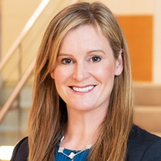
Speaker
Heather Egan Sussman
Partner
Orrick, Herrington & Sutcliffe LLP
Heather Egan Sussman is Head of Orrick's Global Cyber, Privacy & Data Innovation Practice Group. Her practice focuses on privacy, cybersecurity and information management, and she is ranked by Chambers USA, Chambers Global and The Legal 500 United States as a leader in her field. Chambers explains companies turn to Heather because she “understands all the business issues and the dynamics of how to implement privacy programs [and is] extraordinarily thoughtful, very pragmatic and responsive.”
Heather routinely guides clients through the existing patchwork of laws impacting privacy and cybersecurity around the globe. In the U.S. this includes advising on federal and state laws such as FCRA, ECPA, TCPA, HIPAA, CAN-SPAM, GLBA, California’s Consumer Privacy Act, state breach notification laws, and state data security laws, as well as existing self-regulatory frameworks, including those covering online advertising and payment card processing. Outside of the U.S., she manages teams of talented counsel around the world to deliver seamless advice for clients that operate across many jurisdictional lines, developing comprehensive privacy and cybersecurity programs that address competing regulatory regimes. She drafts online privacy notices for global rollout and implements data transfer mechanisms for the free flow of data worldwide.
Notes:
TOM WILL INTRODUCE

Slide 5
Intake
Notes:
Heather F

Slide 6
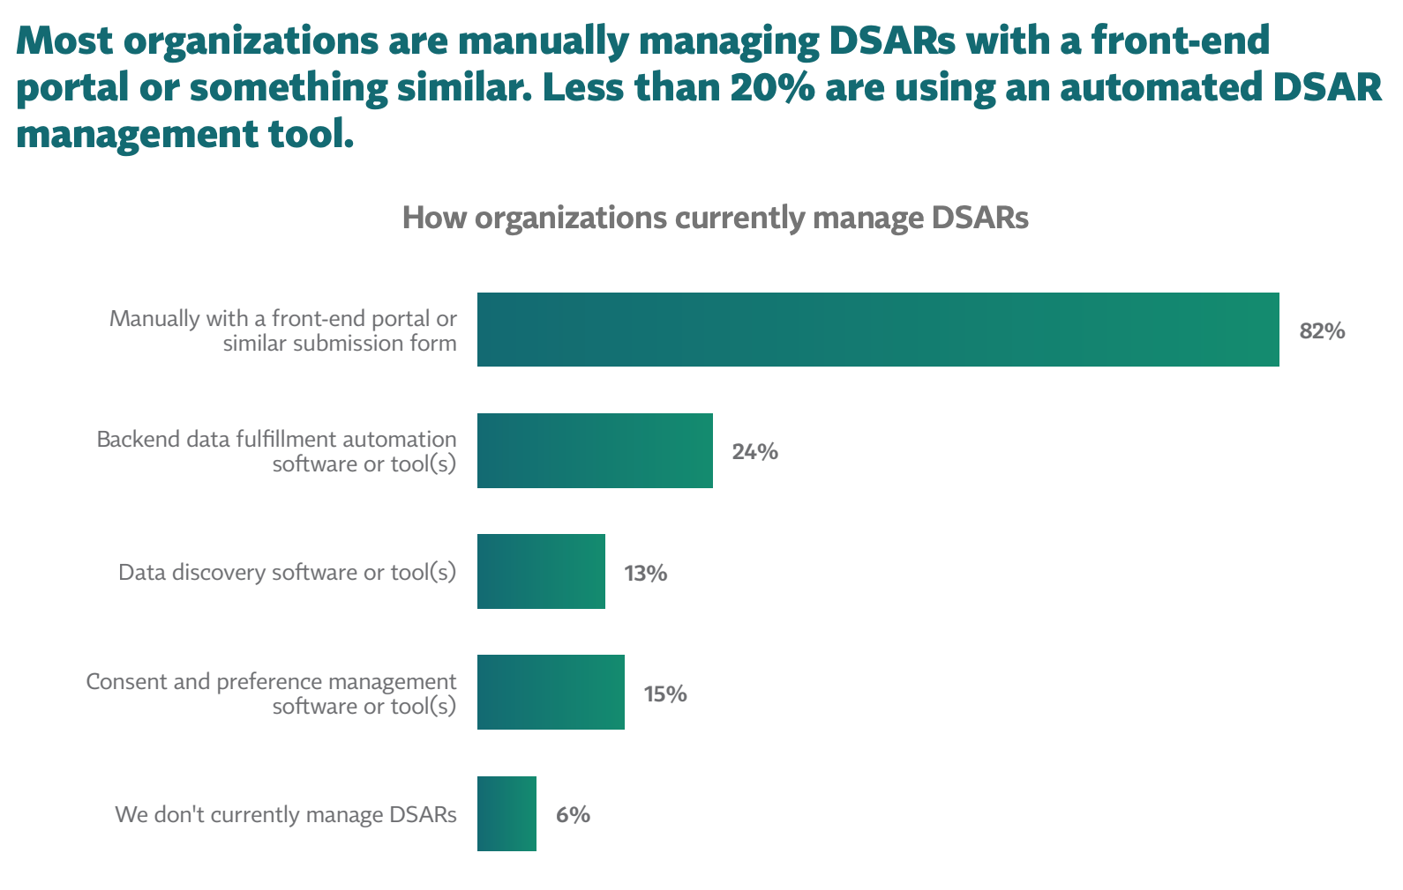
Intake Statistics
Notes:
TOM WILL INTRODUCE

Slide 7
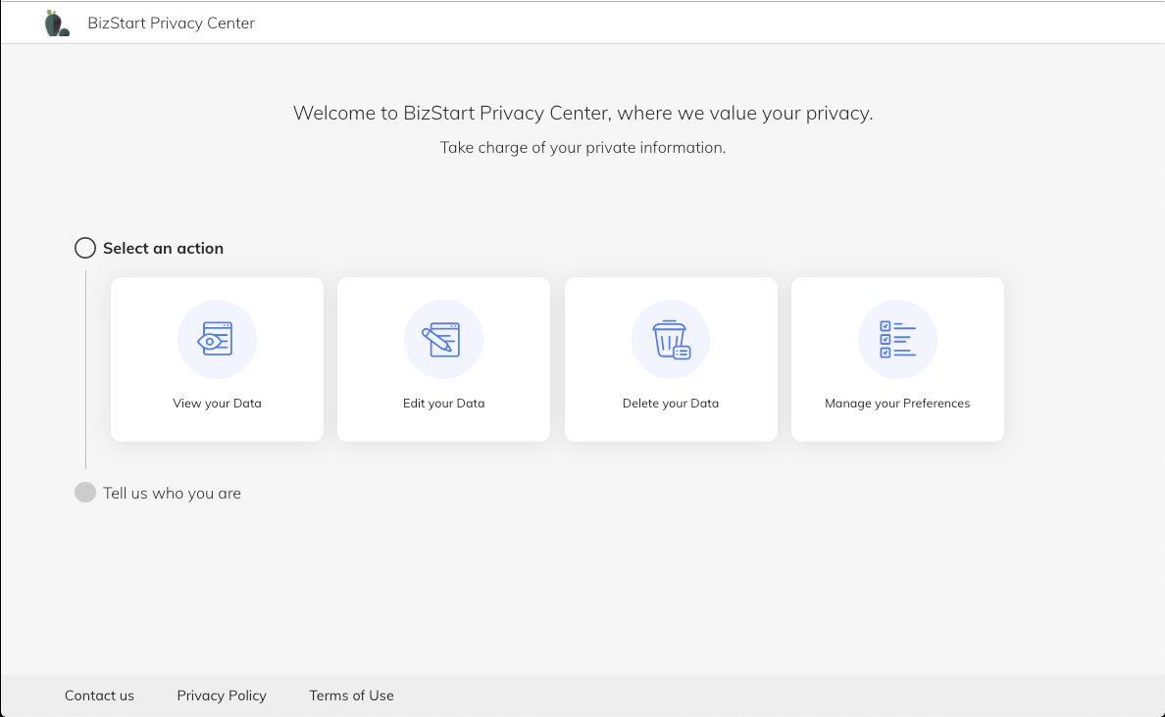
End User Form
Notes:
TOM WILL INTRODUCE

Slide 8
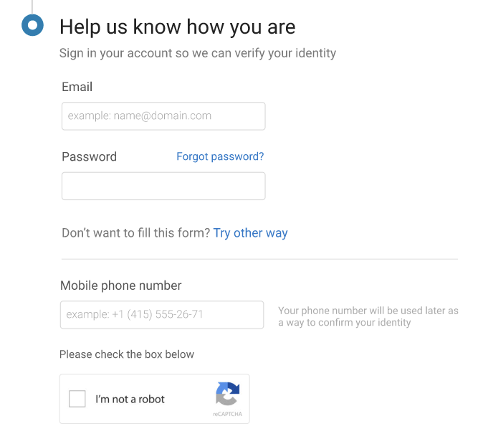
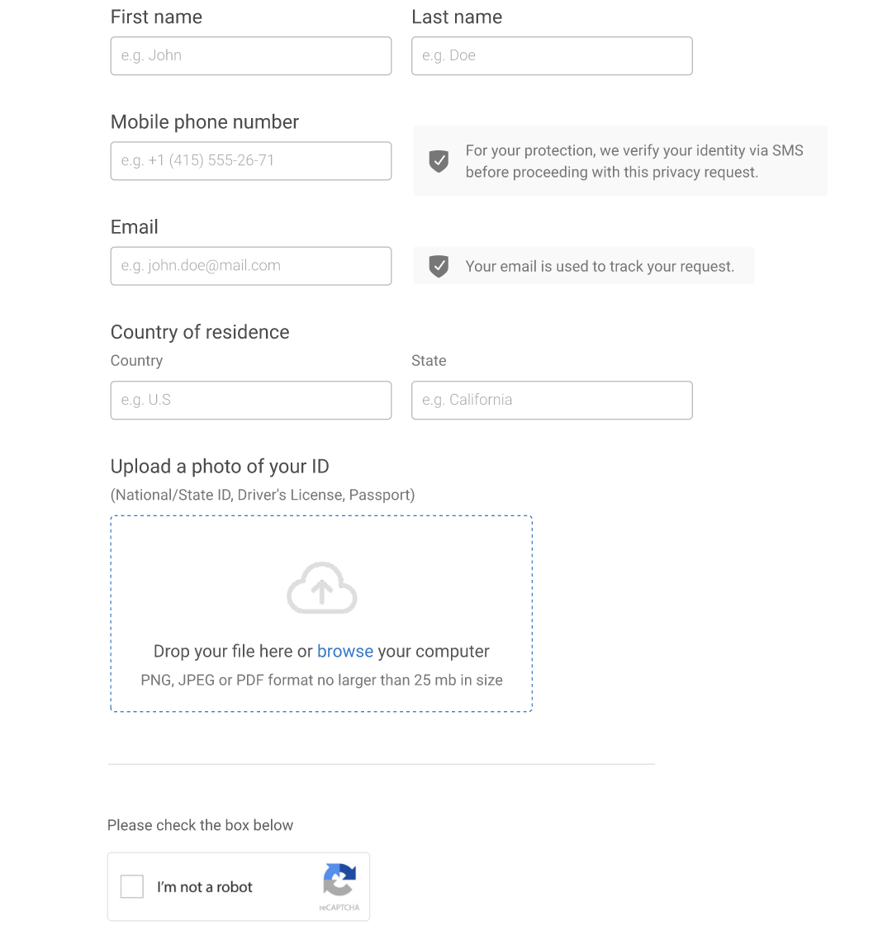
What Info Do YOU Need
What is the minimum amount of data subject info you need?
Have to “know” your customer so they can know themselves
Notes:
TOM WILL INTRODUCE

Slide 9
Evaluation
Notes:
Heather S

Slide 10
Verifying the Request
Focusing in on the CCPA:
Consumer Verification
Parent / Guardian Verification
Household Verification
Authorized Agent Verification

Slide 11
General Rules
Must establish, document and comply with “reasonable method” that considers the way the business interacts with the consumer
Consider sensitivity and value of the data, the risk of harm for unauthorized access or deletion, and the likelihood malicious actors would want the data – the greater the risk the “more stringent” the verification.
“reasonable security” to prevent identity-verification fraud
If information maintained in de-identified form, no requirement to re-identify
Cannot charge a fee for the verification process
If there is no reasonable method way to verify a consumer to the degree of certainty required by law, must “explain why” in your privacy policy

Slide 12
Consumer Verification
For Requests to Know
To verify a consumer’s identity prior to analyzing their request to know, confirm:
The consumer is a resident of the State of California; and
The consumer is the individual about whom the personal information relates by:
Consumer with Password-Protected Account: Following standard account authentication methods for their account
Consumer without Password-Protected Account:
For specific pieces – “reasonably high degree of certainty” standard (matching at least three data points deemed “reliable”), plus signed declaration under pains and penalties of perjury (if not, treat as “categories”)
For categories – “reasonable degree of certainty” at least two matches of data points that are reliable

Slide 13
Consumer Verification (cont.)
For Requests to Delete
Same as Requests to Know -- Consumers without Password-Protected Account:
Higher Deletion Threshold: Where unauthorized deletion of personal information would likely cause meaningful harm to the consumer (such as where the consumer’s account would be closed), verify at least (“reasonably high degree of certainty”):
three pieces of personal information that reliably matches what is maintained, and
a signed declaration under penalty of perjury.
Lower Deletion Threshold: Where unauthorized deletion would likely not cause meaningful harm (such as where the consumer’s email would be removed from a marketing list), verify identity for purposes of their deletion request by obtaining (“reasonable degree”):
at least two pieces of personal information that reliably matches

Slide 14
Parent / Guardian Verification
For a child 13 years old or older:
A letter written and signed by the child containing:
The name and contact information of the child;
The name and contact information of the parent or guardian; and
A statement of authorization for the request.
Or, a separate communication (such as an email) directly from the child confirming the child provided the parent or guardian permission to submit the request on their behalf.
For a child under 13 years old:
A signed letter from the parent or guardian containing:
The name and contact information of the child;
The name and contact information of the parent or guardian; and
A statement that the parent or guardian is the parent or guardian of the child.
A letter from a third-party reference, such as a lawyer, teacher or doctor, providing the reference’s contact information and stating they have knowledge the requester is the parent or guardian of the child.

Slide 15
Household Verification
Avoid disclosing or deleting specific pieces of personal information for a household unless:
All consumers of the household make the request and
You can individually verify all the members of the household as set forth in the “individual consumer verification method” and
You can verify each member making the request is currently a member of the household.
Otherwise, you may only provide aggregate household information (provided the consumer is verified individually)

Slide 16
Authorized Agent Verification
A request submitted by an authorized agent on behalf of a consumer must include:
The information required to process a request from a consumer; and
Sufficient evidence of the authorized agent’s authorization to submit the request on behalf of the consumer.
“Sufficient evidence” will depend on how the request comes in:
From the consumer copying the third party?
From a third-party platform?
From an individual agent acting on behalf of the consumer?

Slide 17
Analysis
After verifying the request, next steps are to:
Identify the scope of the request;
Determine whether the consumer request is manifestly unfounded or excessive; and
Confirm whether any exceptions apply to the request.
There is no requirement that the above actions be taken in order. The appropriate approach to analyzing each consumer request is made on case-by-case basis.
Notes:
Confirm the Scope of the Request
To confirm the scope of the request, business should make reasonable efforts to:
Confirm the type of request being made;
Confirm the type of consumer the request is about (e.g., prospective or actual customer, relevant entity, products and/or services); and
Confirm the scope of the personal information the request covers.
If the scope of the request is unclear in the consumer’s initial or subsequent communications, business should clarify the scope of the request by asking the consumer for additional information or direction. If the scope of the request is different than originally anticipated, business may need to reverify the consumer’s request.
Determine Whether the Consumer Request is Manifestly Unfounded or Excessive
A consumer request may be manifestly unfounded or excessive, such as when requests are:
repetitive in character (see the Two Request Limit for Right to Know requests);
motivated by an unlawful purpose;
motivated by a purpose to harass;
overbroad to the degree it may impact the privacy of others; or
asking for information in a medium that would result in substantial administrative costs.
If a consumer request is manifestly unfounded or excessive, we may either:
charge a reasonable fee, considering the administrative costs of providing the information or communication or taking the action requested; or
refuse to act on the request and notify the consumer of the reason for refusing the request.
If business decides to charge a reasonable fee and the consumer refuses to pay, business may refuse to act on the request and notify the consumer of the reason for refusing the request. If business decides to charge a reasonable fee or refuse to act on the request, business should be able to demonstrate through documentation why the consumer’s request is manifestly unfounded or excessive.

Slide 18
Fulfillment
Notes:
Rachel

Slide 19
Fulfillment
Data Inventory: Where do we find the data? What are we processing? Whose data is it?
What is included in our response? How do we define personal information vs. non personal information
Third party data providers- how to manage the data that they have
Response
Notes:
TOM WILL INTRODUCE

Slide 20
Response
Notes:
Heather F

Slide 21
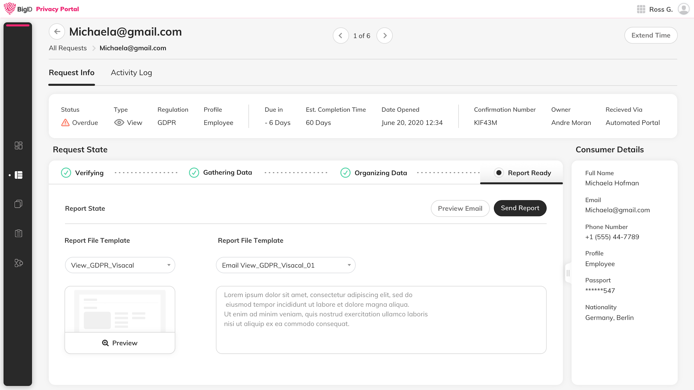
Customizable Data Subject Report
Organization of gathered information
Open question: what data’s included within the report
Template or SDK for integration into web and mobile portals
Notes:
Over inclusive vs. under inclusive - who would find out if making judgement calls in the grey area

Slide 22
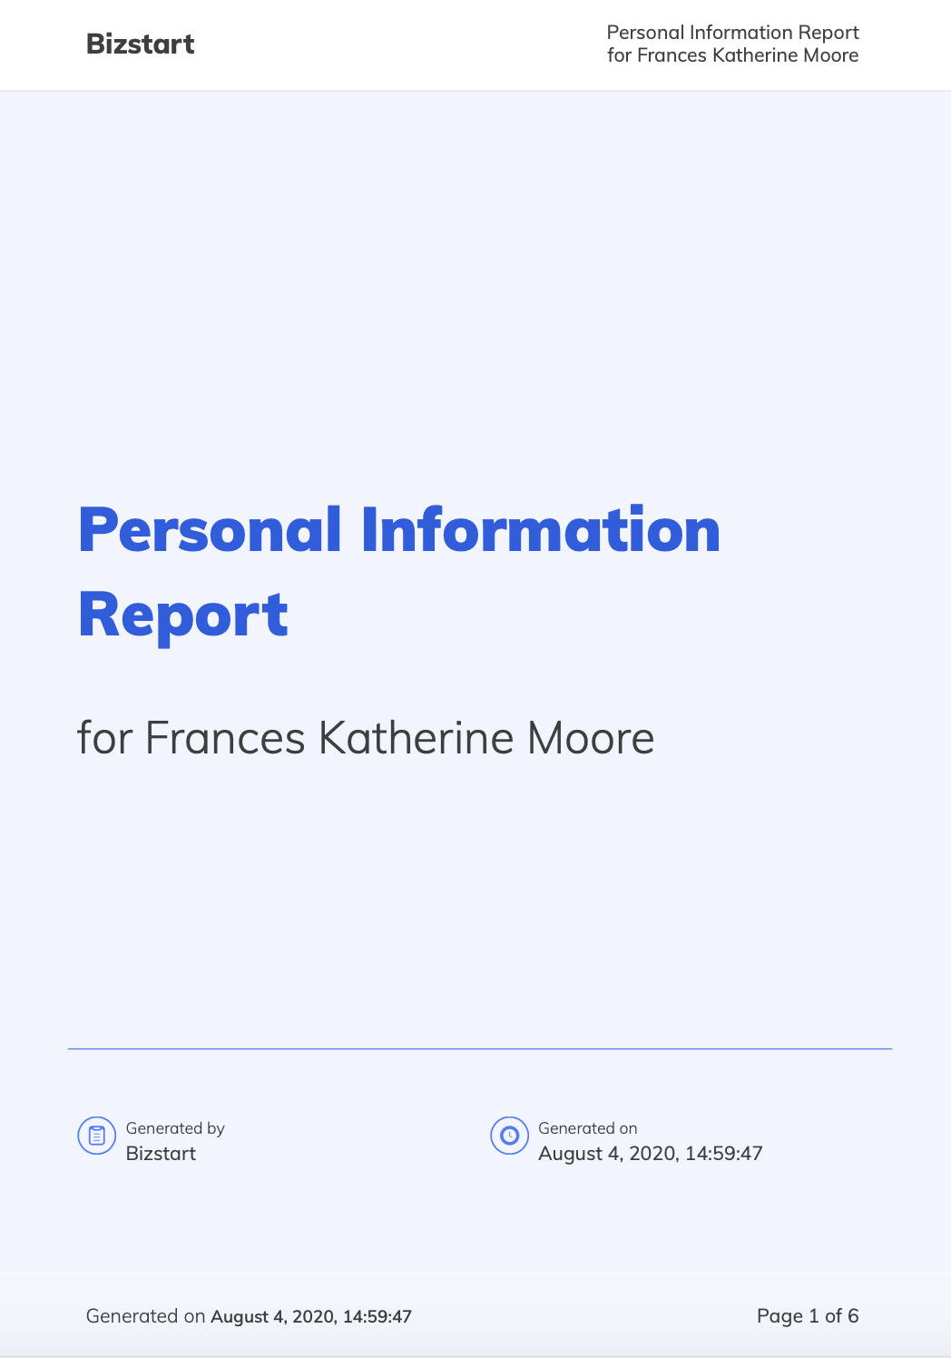
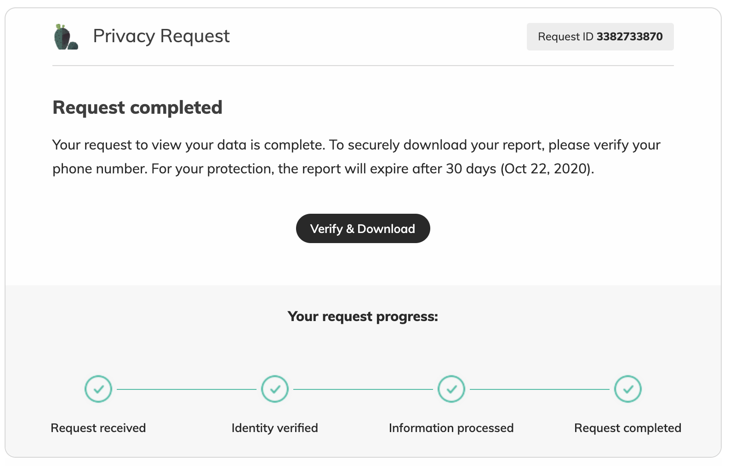
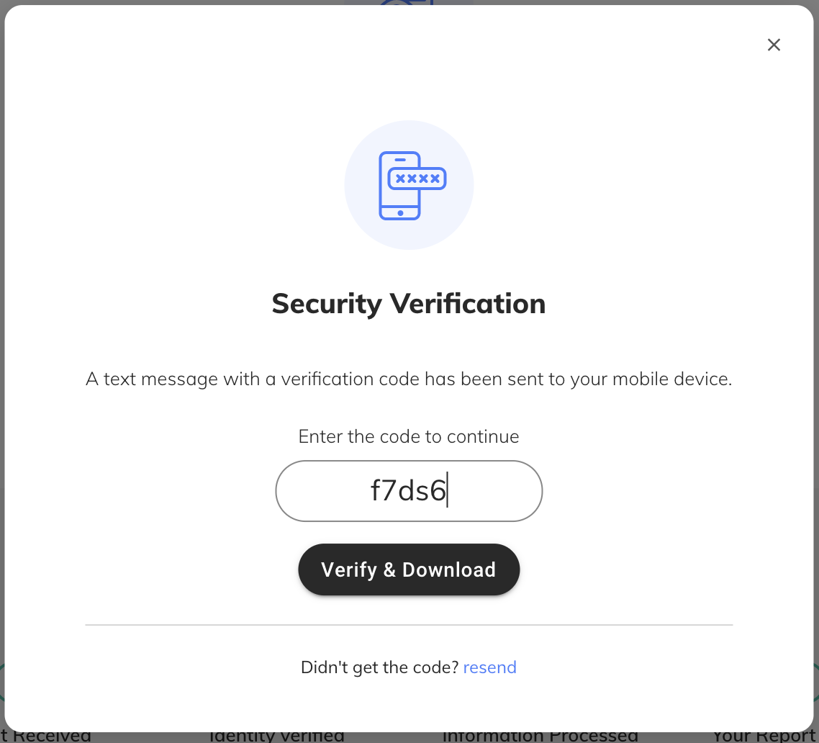
End User POV

Slide 23
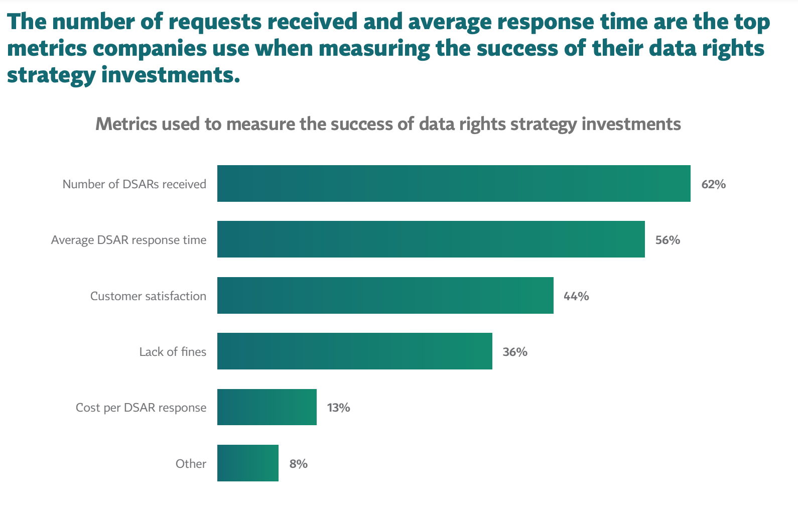
DSARs Metrics

Slide 24
Resolution and Recordkeeping
Notes:
Heather S

Slide 25
Resolution and Recordkeeping
Log requests to document the following:
Date of the request;
Nature of the request;
Manner in which the request was made;
Date of response;
Nature of response;
Basis for denial of request (if denied in whole or in part); and
All verification-related documentation.
Maintain records for a minimum of 24 months; and keep them secure
If process personal information of more than 10M or more consumers in a calendar year
Notes:
TOM WILL INTRODUCE

Slide 26
Takeaways
Know your business
Know what data you have and where it is
Be true to your process
Planning is everything

Slide 27
Questions + Contact
Heather Federman
VP of Privacy & Policy
BigID
HeatherF@bigid.com
Rachel Glasser
Chief Privacy Officer
Wunderman Thompson
Rachel.Glasser@wundermanthompson.com
Heather Sussman
Partner
Orrick
hsussman@orrick.com
Notes:
TOM WILL INTRODUCE

