Slide 1
CPRA and State Law Privacy and Cybersecurity Litigation – What Litigators and Compliance Lawyers Miss
Ian Ballon, JD, LLM, CIPP/US
Co-Chair, Global IP & Technology
Practice Group
Greenberg Traurig LLP
(650) 289-7881 (310) 586-6575 (202) 331-3138
Ballon@GTLaw.com
www.IanBallon.net
Doug Smith
Executive Director, Cybersecurity & Privacy Legal
Morgan Stanley
Ann Staggs
Lead Privacy Counsel
Airbnb
www.linkedin.com/in/ans415

Slide 2
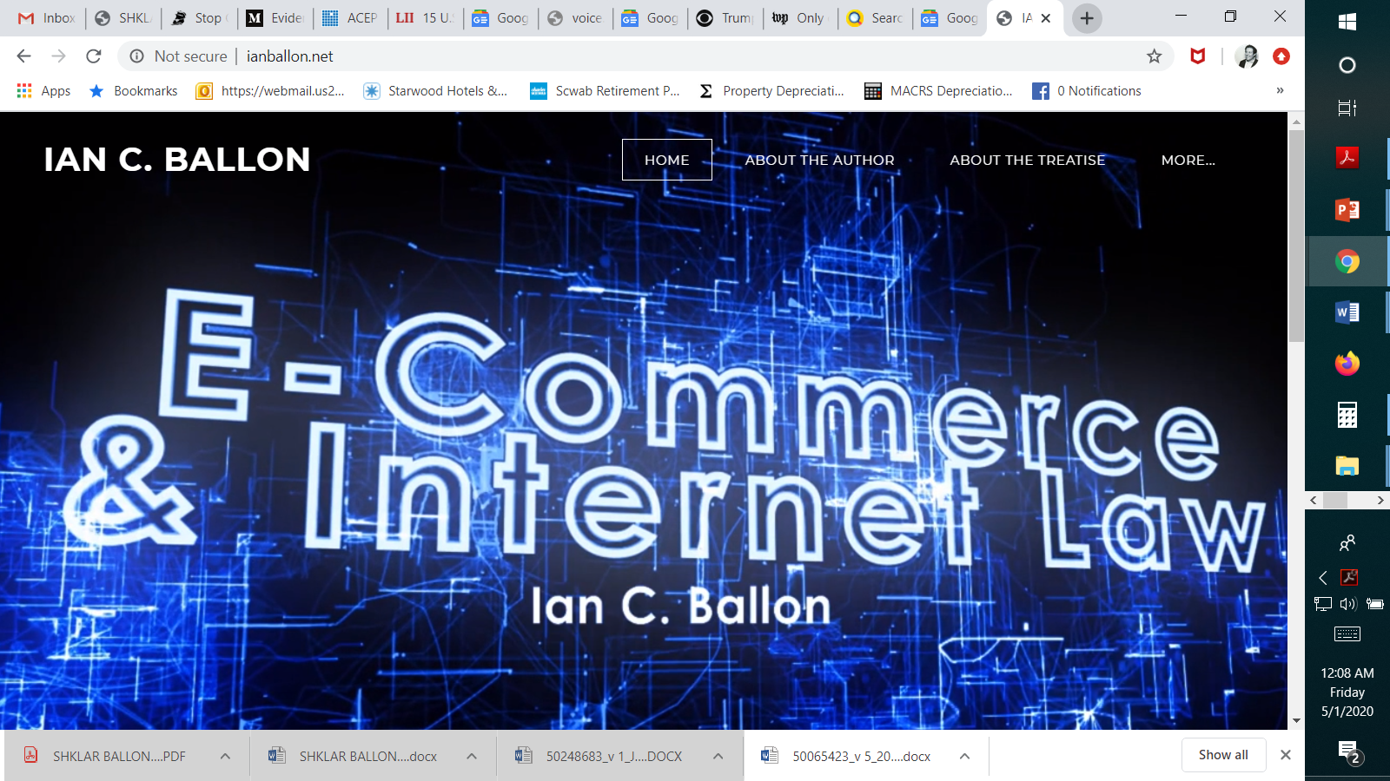

Slide 3
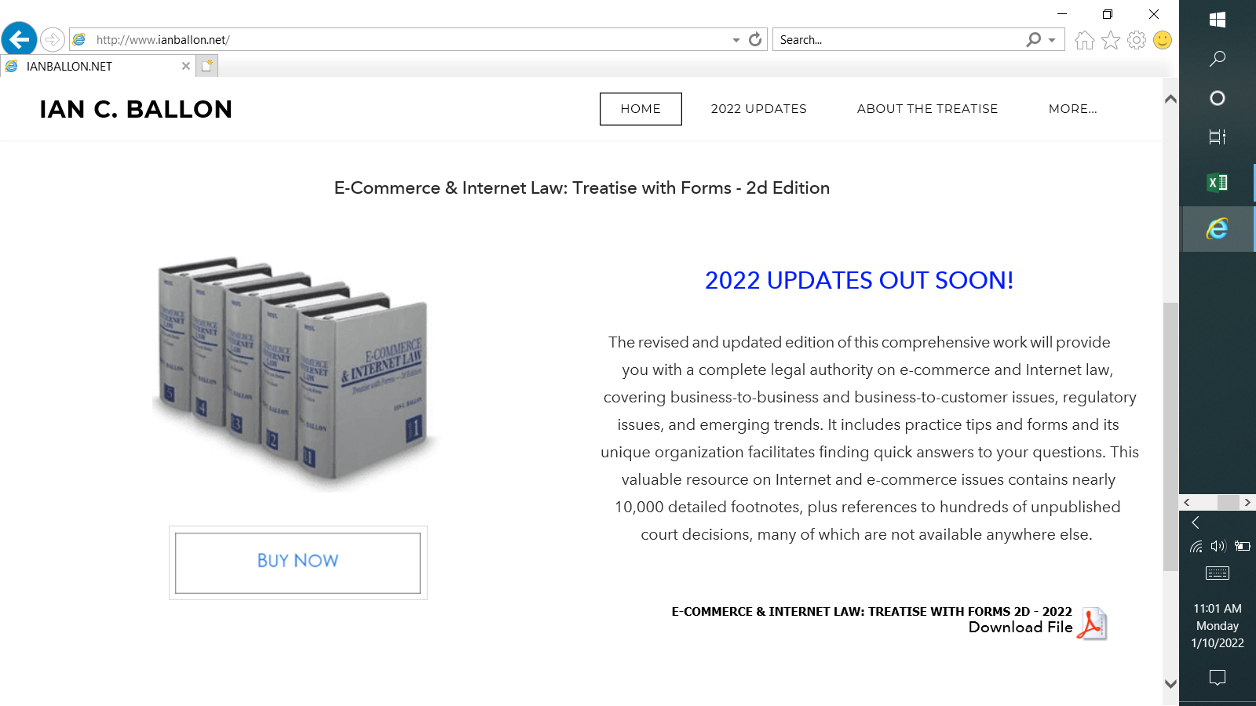

Slide 4
The California consumer privacy act (ccpa) & California Privacy Rights and Enforcement Act of 2020 (CPRA)

Slide 5
Defense Strategies for CCPA & Other Cybersecurity litigation
Many “CCPA claims” aren’t actually actionable under the CCPA
The CCPA creates a private right of action for
[1] consumers
[2] “whose nonencrypted or nonredacted
[3] personal information [within the meaning of Cal. Civ. Code §§ 1798.150(a)(1) and 1798.81.5] . . .
[4] is subject to an unauthorized access and exfiltration, theft, or disclosure
[5] as a result of the business’s
[6] violation of the duty to implement and maintain reasonable security procedures and practices . . . .”
Cal. Civ. Code § 1798.150(c) (“Nothing in this title shall be interpreted to serve as the basis for a private right of action under any other law.”)
Should you respond to a CCPA 30 day cure notice and if so how?
Court opinions
Rahman v. Marriott International, Inc., Case No. SA CV 20-00654-DOC-KES, 2021 WL 346421 (C.D. Cal. Jan. 12, 2021) (dismissing CCPA, breach of contract, breach of implied contract, unjust enrichment and unfair competition claims, for lack of Article III standing, in a suit arising out of Russian employees accessing putative class members’ names, addresses, and other publicly available information, because the sensitivity of personal information, combined with its theft, are prerequisites to finding that a plaintiff adequately alleged injury in fact)
Gardiner v. Walmart Inc., Case No. 20-cv-04618-JSW, 2021 WL 2520103, at *2-3 (N.D. Cal. Mar. 5, 2021) (dismissing plaintiff’s CCPA claim for failing to allege that the breach occurred after January 1, 2020, when the CCPA took effect, and failing to adequately allege the disclosure of personal information as defined by the statute)
Gershfeld v. Teamviewer US, Inc., 2021 WL 3046775 (C.D. Cal. June 24, 2021) (dismissing claim)
Silver v. Stripe Inc., 2021 WL 3191752 (N.D. Cal. July 28, 2021) (no UCL claim based on CCPA)
In re Blackbaud, Inc., Customer Data Breach Litig., 2021 WL 3568394, at *4-6 (D.S.C. Aug. 12, 2021) (denying motion to dismiss where plaintiff adequately alleged d a business)

Slide 6
How will litigation change under the CPRA?
The CPRA was adopted as a ballot initiative in November 2020 and will amend the CCPA litigation section effective January 1, 2023
The litigation remedies are largely the same except:
New thresholds for CPRA applicability for a business (and covers sharing)
Expanded to cover anyone whose email address in combination with a password or security question and answer that would permit access to the account was subject to an unauthorized access and exfiltration, theft, or disclosure
The CPRA will apply to businesses engaged in consumer credit collection and reporting
New caveat on what constitutes a cure
Online contract formation
Representative action nonwaiver
New threshold: The CPRA applies to businesses with (1) annual gross revenue > $25 M; (2) that buy, sell or receive for commercial purposes personal information of (50,000) 100,00 or more consumers, households or devices, and (3) businesses that derive 50% or more of their annual revenue from selling (buying or sharing) consumers’ personal information (excludes entities subject to federal regulation)
New Civil Code § 1798.150 - implementation and maintenance of reasonable security procedures and practices does not amount to a cure (in response to a 30 day letter)
New Civil Code § 1798.140(h) - Consent does not include "acceptance of a general or broad terms of use" that describes "personal information processing along with other, unrelated information . . . .“
New Civil Code § 1798.192 – prohibits and renders void “a representative action waiver”

Slide 7
The ILLINOIS BIOMETRIC INFORMATION PRIVACY ACT

Slide 8
Illinois Biometric Information Privacy Act
Illinois Biometric Information Privacy Act (BIPA)
A private cause of action for "any person aggrieved by a violation" of BIPA
Rosenbach v. Six Flags Entertainment Corp., 129 N.E.3d 1197 (Ill. 2019) (holding that a person need not have sustained actual damage beyond violation of his or her rights under the statute to be aggrieved by a violation)
A plaintiff may recover the greater of (1) actual damages or (2) $1,000 in liquidated damages for negligent violations or $5,000 if intentional or reckless
The statute also authorizes recovery of attorneys' fees
Cothron v. White Castle System, Inc., 20 F.4th 1156 (7th Cir. 2021) (holding employees had standing to assert a BIPA claim alleging that the employer’s fingerprint-scanning and verification system violated the statute; certifying (to the Illinois Supreme Court) the question of whether a BIPA claim accrues each time a person's biometric identifier is scanned and each time it is transmitted, or only upon the first scan and first transmission)
Patel v. Facebook, 932 F.3d 1264 (9th Cir. 2019) (affirming certification of a class of Illinois users of Facebook’s website for whom the website created and stored a face template during the relevant time period) (petition for cert. filed Dec. 4, 2019)

Slide 9
ADTECH-RELATED PRIVACY LITIGATION

Slide 10
AdTech Cases Involving Replay Software
California law
Massie v. General Motors LLC, Civil Action No. 21-787-RGA2022 WL 534468 (D. Del. Feb. 17, 2022) (dismissing plaintiffs’ Wiretap Act and CIPA claims, arising out of GM's use of Decibel's Session Replay software on GM's websites, for lack of Article III standing)
Saleh v. Nike, Inc., _ F. Supp. 3d _, 2021 WL 4437734, at *12-14 (C.D. Cal. Sept. 27, 2021) (dismissing plaintiff’s CIPA section 635 claim, alleging use of FullStory session replay software, because “[c]ontrary to Plaintiff's argument, § 635 does not prohibit the ‘implementation’ or ‘use’ of a wiretapping device; instead, it prohibits the manufacture, assembly, sale, offer for sale, advertisement for sale, possession, transport, import, or furnishment of such device” and ruling, by analogy to ECPA, that a private cause of action may not be premised on mere possession and therefore plaintiff lacked Article III standing)
Graham v. Noom, Inc., No. 3:20-cv-6903, 2021 WL 1312765, at *7-8 (N.D. Cal. Apr. 8, 2021) (dismissing plaintiffs’ 635(a) CIPA claim because plaintiffs could not allege eavesdropping where FullStory merely provided a cloud-based software tool and acted as “an extension of Noom[,]” and thus there could be no section 635 violation and plaintiffs lacked Article III standing)
Yale v. Clicktale, Inc., No. 3:20-cv-7575, 2021 WL 1428400, at *3 (N.D. Cal. Apr. 15, 2021) (applying Noom to reach the same result); Johnson v. Blue Nile, Inc., No. 3:20-cv-8183, 2021 WL 1312771, at *3 (N.D. Cal. Apr. 8, 2021) (applying Noom to reach the same result)
Florida law
Jacome v. Spirit Airlines Inc., No. 2021-000947-CA-01, 2021 WL 3087860, at *2 (Fla. Cir. June 11, 2021) (holding that sections 934.03(1)(a) and 934.03(1)(d) of the Florida Security of Communications Act’s purpose was “to address eavesdropping and illegal recordings regarding the substance of communications or personal and business records . . . and not to address the use by a website operator of analytics software to monitor visitors' interactions with that website operator's own website. . . . [T]he FSCA does not cover Plaintiff's claims seeking to penalize Spirit's use of session replay software on its Website.”)

Slide 11
AdTech Cases Involving Online Chat
California law

Slide 12
SECURITY BREACH, DATA PRIVACY & AdTech PUTATIVE CLASS ACTION LITIGATION

Slide 13
Cybersecurity/Data Privacy Class Action Litigation
Cybersecurity claims
Breach of contract (if there is a contract)
Breach of the covenant of good faith and fair dealing (if the contract claim isn’t on point)
Breach of implied contract (if there is no express contract)
Breach of fiduciary duty, Negligence, Fraud, unfair competition
State cybersecurity statutes (especially those that provide for statutory damages and attorneys’ fees)
California (and potentially Oregon) IoT Law, CCPA
Securities fraud – federal and state law claims
In re Alphabet, Inc. Securities Litigation, 1 F.4th 687 (9th Cir. 2021)
In re Facebook, Inc. Securities Litigation, 477 F. Supp. 3d 980 (N.D. Cal. 2020) (dismissing plaintiffs' amended complaint for lack of causation and reliance)
Data privacy claims – state law claims
Negligence
Unfair competition
Breach of contract/ privacy policies
Bass v. Facebook, Inc., 394 F. Supp. 3d 1024, 1037-38 (N.D. Cal. 2019) (dismissing claims for breach of contract, breach of implied contract, breach of the implied covenant of good faith and fair dealing, quasi contract, and breach of confidence in a putative data security breach class action suit, where Facebook’s Terms of Service included a limitation-of-liability clause)
Data privacy claims – early claims premised on federal law
Electronic Communications Privacy Act
Wiretap Act
Stored Communications Act
Computer Fraud and Abuse Act
$5,000 minimum injury
Van Buren v. United States, 141 S. Ct. 1648 (2021)
Video Privacy Protection Act
Regulatory enforcement – the FTC and potentially state Attorneys General, including in California Coordinate litigation and regulatory enforcement (usually confidential)

Slide 14
Defense Strategies for Data Privacy & Cybersecurity litigation
Can you compel arbitration?
If there are multiple suits – is MDL consolidation possible or desirable?
Security breach cases are often consolidated in the district where the defendant is located
In re Dickey’s Barbecue Restaurants, Inc., Customer Data Security Breach Litigation, 521 F. Supp. 3d 1355 (J.P.M.D.L. 2021) (denying consolidation)
Motions to Dismiss
Rule 12(b)(1) standing – circuit split - 6th, 7th, 9th, DC vs. high threshold: 2d, 4th, 8th (3d)
Do you want to be in state or federal court?
Rule 12(b)(6) motion to dismiss for failure to state a claim
Summary judgment
Class Certification
Work Product and other privileges
In re: Capital One Consumer Data Security Breach Litig., MDL No. 1:19md2915, 2020 WL 3470261 (E.D. Va. June 25, 2020) (Ordering production of the Mandiant Report)
Applied the 4th Circuit’s “driving force” test – (1) was the report prepared when the litigation was a real likelihood (yes); (2) would it have been created anyway in the absence of litigation (yes)
Capital One had a preexisting contractual relationship with Mandiant for similar reports and could not show that, absent the breach, the report would have been any different in addressing business critical issues (and the report was widely distributed to 50 employees, 4 different regulators and an accountant)
Footnote 8: use different vendors, scopes of work and/or different investigation teams
In re: Capital One Consumer Data Security Breach Litig., MDL No. 1:19md2915, 2020 WL 5016930 (E.D. Va. Aug. 21, 2020) (Price Waterhouse – not produced)
The Ninth Circuit does not weigh motivations where documents may be used both for business purposes and litigation: In re Grand Jury Subpoena, 357 F.3d 900, 908 (9th Cir. 2004)
Cf. In re Grand Jury Subpoena, 13 F.4th 710 (9th Cir. 2021)
Settlement

Slide 15
Cybersecurity Breach Class Action Litigation - Standing
Circuit split on Article III standing: Low threshold: 6th, 7th, 9th, DC vs. higher: 2d, 4th, 8th, 11th (3d)
TransUnion LLC v. Ramirez, 141 S. Ct. 2190 (2021)
Remijas v. Neiman Marcus Group, 794 F.3d 688 (7th Cir. 2015)
Lewert v. P.F. Chang’s China Bistro Inc., 819 F.3d 963 (7th Cir. 2016)
Galaria v. Nationwide Mut. Ins. Co., 663 F. App’x 384 (6th Cir. 2016) (2-1)
Reilly v. Ceridian Corp., 664 F.3d 38 (3d Cir. 2011), cert. denied, 566 U.S. 989 (2012)
Clemens v. ExecuPharm Inc., 48 F.4th 146 (3d Cir. 2020) (holding that an employee had standing to sue her employer and its parent company, alleging negligence, negligence per se, breach of contract and breach of implied contract, breach of fiduciary duty and reach of confidence, in connection with a data breach that resulted in publication of her sensitive personal information on the dark web)
Beck v. McDonald, 848 F.3d 262 (4th Cir. 2017)
Allegation that data breaches created an enhanced risk of future identity theft was too speculative
Rejected evidence that 33% of health related data breaches result in identity theft
Rejected the argument that offering credit monitoring services evidenced a substantial risk of harm (rejecting Remijas)
Mitigation costs in response to a speculative harm do not qualify as injury in fact
Whalen v. Michael’s Stores, Inc., 689 F. App’x. 89 (2d Cir. 2017)
The theft of plaintiff’s credit card numbers was not sufficiently concrete or particularized to satisfy Spokeo (name, address, PIN not exposed)
credit card was presented for unauthorized charges in Ecuador, but no allegation that fraudulent charges actually were incurred
McMorris v. Carlos Lopez & Associates, LLC, 995 F.3d 295 (2d Cir. 2020)
Plaintiffs may establish Article III standing based on an increased risk of identity theft or fraud following the unauthorized disclosure of their data, but employee was not at substantial risk of future identity theft
Attias v. Carefirst, Inc., 865 F.3d 620 (D.C. Cir. 2017), cert. denied, 138 S. Ct. 981 (2018) following Remijas v. Neiman Marcus Group, LLC in holding that plaintiffs, whose information had been exposed but who were not victims of identity theft, had plausibly alleged a heightened risk of future injury because it was plausible to infer that a party accessing plaintiffs’ personal information did so with “both the intent and ability to use the data for ill.”)
In re U.S. Office of Personnel Management Data Security Breach Litig., 928 F.3d 42 (D.C. Cir. 2019) (21M records)
In re SuperValu, Inc., Customer Data Security Breach Litig., 870 F.3d 763 (8th Cir. 2017)
Affirming dismissal for lack of standing of the claims of 15 of the 16 plaintiffs but holding that the one plaintiff who alleged he suffered a fraudulent charge on his credit card had standing
Rejected cost of mitigation (Clapper) (Cf. P.F. Chang’s)
In re Zappos.com, Inc., 888 F.3d 1020 (9th Cir. 2018), cert. denied, 139 S. Ct. 1373 (2019)
Merely having personal information exposed in a security breach constitutes sufficient harm to justify Article III standing in federal court, regardless of whether the information in fact is used for identity theft or other improper purposes
Bootstrapping - Because other plaintiffs alleged that their accounts or identities had been commandeered by hackers, the court concluded that the appellants in Zappos – who did not allege any such harm – could be subject to fraud or identity theft
Tsao v. Captiva MVP Restaurant Partners, LLC, 986 F.3d 1332 (11th Cir. 2021)
No Article III standing for mitigation injuries (lost time, lost reward points, lost access to accounts) or potential future injury, where plaintiff’s credit card was exposed when a restaurant’s point of sale system was breached

Slide 16
ONLINE AND MOBILE CONTRACT FORMATION

Slide 17
Online and Mobile Contract Formation
Trend: Continued hostility to implied contracts
Berman v. Freedom Financial Network, LLC, 30 F.4th 849 (9th Cir. 2022)
Sifuentes v. Dropbox, Inc., 2021 WL 2673080 (N.D. Cal. June 29, 2022)
Emmanuel v. Handy Technologies, Inc., 992 F.3d 1 (1st Cir. 2021) (enforcing ToS and arbitration provision under Mass law where plaintiff selected ‘Accept’ in a mobile app)
Nguyen v. Barnes & Noble Inc., 763 F.3d 1171, 1175-79 (9th Cir. 2014)
declining to enforce an arbitration clause
“where a website makes its terms of use available via a conspicuous hyperlink on every page of the website but otherwise provides no notice to users nor prompts them to take any affirmative action to demonstrate assent, even close proximity of the hyperlink to relevant buttons users must click on—without more—is insufficient to give rise to constructive notice”
Wilson v. Huuuge, Inc., 944 F.3d 1212 (9th Cir. 2019)
declining to enforce an arbitration clause in a mobile Terms of Service agreement
Dohrmann v. Intuit, Inc., 823 F. App’x 482 (9th Cir. 2020)
Reversing the denial of a motion to compel arbitration
Holding the arbitration provision in Intuit’s Terms of Use enforceable where a user, to access a TurboTax account, was required, after entering a user ID and password, to click a “Sign In” button, directly above the following language: “By clicking Sign In, you agree to the Turbo Terms of Use, TurboTax Terms of Use, and have read and acknowledged our Privacy Statement,” where each of those documents was highlighted in blue hyperlinks which, if clicked, directed the user to a new webpage containing the agreement
Lee v. Ticketmaster L.L.C., 817 F. App’x 393 (9th Cir. 2020)
Nicosia v. Amazon.com, Inc., 834 F.3d 220 (2d Cir. 2016)
Reversing the lower court's order dismissing plaintiff's complaint, holding that whether the plaintiff was on inquiry notice of contract terms, including an arbitration clause, presented a question of fact where the user was not required to specifically manifest assent to the additional terms by clicking "I agree" and where the hyperlink to contract terms was not "conspicuous in light of the whole webpage."
Meyer v. Uber Technologies, Inc., 868 F.3d 66 (2d Cir. 2017)
(1) Uber’s presentation of its Terms of Service provided reasonably conspicuous notice as a matter of California law and (2) consumers’ manifestation of assent was unambiguous
“when considering the perspective of a reasonable smartphone user, we need not presume that the user has never before encountered an app or entered into a contract using a smartphone. Moreover, a reasonably prudent smartphone user knows that text that is highlighted in blue and underlined is hyperlinked to another webpage where additional information will be found.”
“[T]here are infinite ways to design a website or smartphone application, and not all interfaces fit neatly into the clickwrap or browsewrap categories.”
Cullinane v. Uber Technologies, Inc., 893 F.3d 53 (1st Cir. 2018)
Displaying a notice of deemed acquiescence and a link to the terms is insufficient to provide reasonable notice to consumers
Ways to make future amendments enforceable

Slide 18
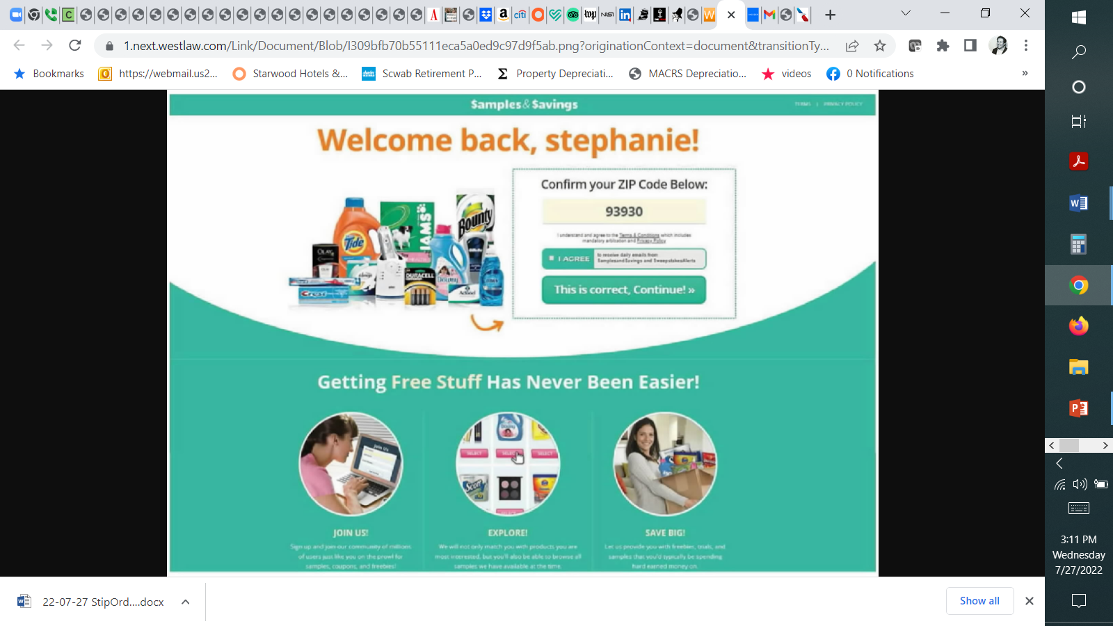

Slide 19
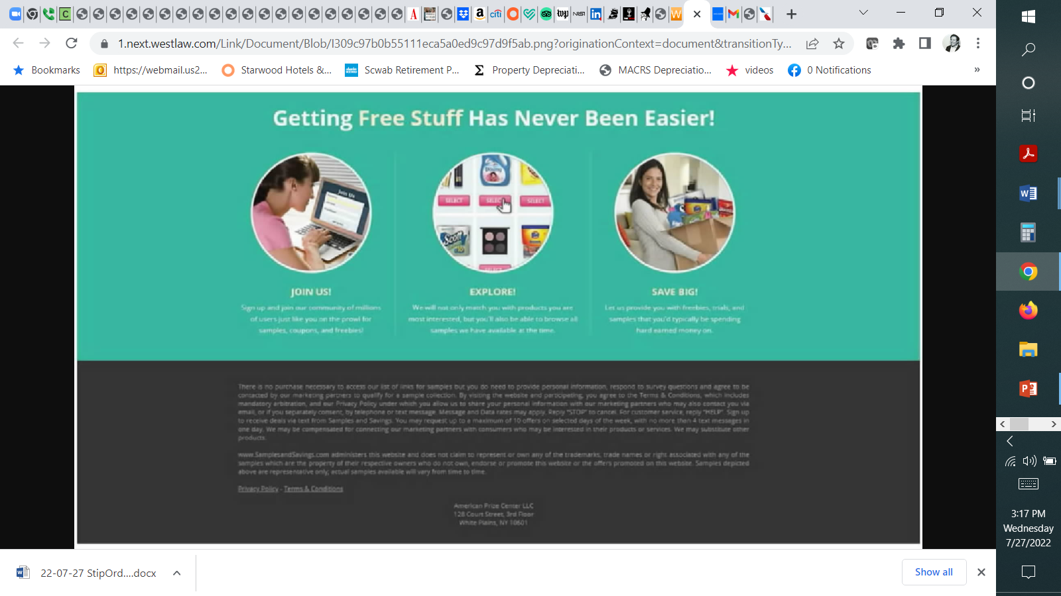

Slide 20
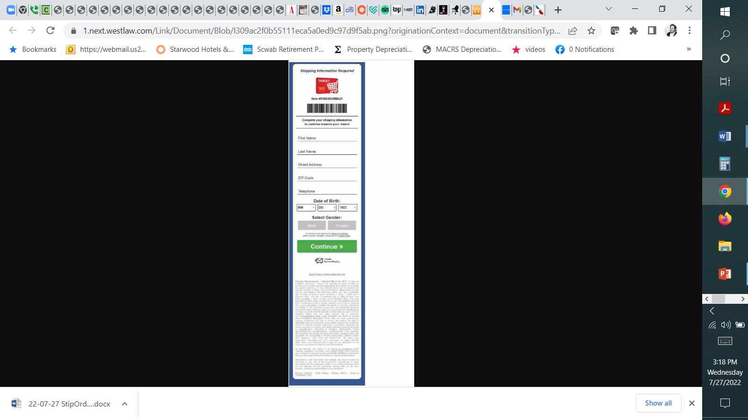

Slide 21
Online and Mobile Contract Formation
Trend: Continued hostility to implied contracts
Berman v. Freedom Financial Network, LLC, 30 F.4th 849 (9th Cir. 2022)
Sifuentes v. Dropbox, Inc., 2021 WL 2673080 (N.D. Cal. June 29, 2022)
Emmanuel v. Handy Technologies, Inc., 992 F.3d 1 (1st Cir. 2021) (enforcing ToS and arbitration provision under Mass law where plaintiff selected ‘Accept’ in a mobile app)
Nguyen v. Barnes & Noble Inc., 763 F.3d 1171, 1175-79 (9th Cir. 2014)
declining to enforce an arbitration clause
“where a website makes its terms of use available via a conspicuous hyperlink on every page of the website but otherwise provides no notice to users nor prompts them to take any affirmative action to demonstrate assent, even close proximity of the hyperlink to relevant buttons users must click on—without more—is insufficient to give rise to constructive notice”
Wilson v. Huuuge, Inc., 944 F.3d 1212 (9th Cir. 2019)
declining to enforce an arbitration clause in a mobile Terms of Service agreement
Dohrmann v. Intuit, Inc., 823 F. App’x 482 (9th Cir. 2020)
Reversing the denial of a motion to compel arbitration
Holding the arbitration provision in Intuit’s Terms of Use enforceable where a user, to access a TurboTax account, was required, after entering a user ID and password, to click a “Sign In” button, directly above the following language: “By clicking Sign In, you agree to the Turbo Terms of Use, TurboTax Terms of Use, and have read and acknowledged our Privacy Statement,” where each of those documents was highlighted in blue hyperlinks which, if clicked, directed the user to a new webpage containing the agreement
Lee v. Ticketmaster L.L.C., 817 F. App’x 393 (9th Cir. 2020)
Nicosia v. Amazon.com, Inc., 834 F.3d 220 (2d Cir. 2016)
Reversing the lower court's order dismissing plaintiff's complaint, holding that whether the plaintiff was on inquiry notice of contract terms, including an arbitration clause, presented a question of fact where the user was not required to specifically manifest assent to the additional terms by clicking "I agree" and where the hyperlink to contract terms was not "conspicuous in light of the whole webpage."
Meyer v. Uber Technologies, Inc., 868 F.3d 66 (2d Cir. 2017)
(1) Uber’s presentation of its Terms of Service provided reasonably conspicuous notice as a matter of California law and (2) consumers’ manifestation of assent was unambiguous
“when considering the perspective of a reasonable smartphone user, we need not presume that the user has never before encountered an app or entered into a contract using a smartphone. Moreover, a reasonably prudent smartphone user knows that text that is highlighted in blue and underlined is hyperlinked to another webpage where additional information will be found.”
“[T]here are infinite ways to design a website or smartphone application, and not all interfaces fit neatly into the clickwrap or browsewrap categories.”
Cullinane v. Uber Technologies, Inc., 893 F.3d 53 (1st Cir. 2018)
Displaying a notice of deemed acquiescence and a link to the terms is insufficient to provide reasonable notice to consumers
Ways to make future amendments enforceable

Slide 24
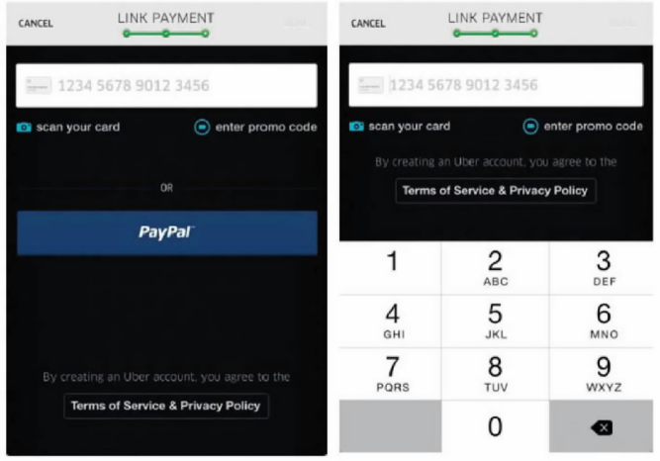

Slide 25
Online and Mobile Contract Formation
Trend: Continued hostility to implied contracts
Berman v. Freedom Financial Network, LLC, 30 F.4th 849 (9th Cir. 2022)
Sifuentes v. Dropbox, Inc., 2021 WL 2673080 (N.D. Cal. June 29, 2022)
Emmanuel v. Handy Technologies, Inc., 992 F.3d 1 (1st Cir. 2021) (enforcing ToS and arbitration provision under Mass law where plaintiff selected ‘Accept’ in a mobile app)
Nguyen v. Barnes & Noble Inc., 763 F.3d 1171, 1175-79 (9th Cir. 2014)
declining to enforce an arbitration clause
“where a website makes its terms of use available via a conspicuous hyperlink on every page of the website but otherwise provides no notice to users nor prompts them to take any affirmative action to demonstrate assent, even close proximity of the hyperlink to relevant buttons users must click on—without more—is insufficient to give rise to constructive notice”
Wilson v. Huuuge, Inc., 944 F.3d 1212 (9th Cir. 2019)
declining to enforce an arbitration clause in a mobile Terms of Service agreement
Dohrmann v. Intuit, Inc., 823 F. App’x 482 (9th Cir. 2020)
Reversing the denial of a motion to compel arbitration
Holding the arbitration provision in Intuit’s Terms of Use enforceable where a user, to access a TurboTax account, was required, after entering a user ID and password, to click a “Sign In” button, directly above the following language: “By clicking Sign In, you agree to the Turbo Terms of Use, TurboTax Terms of Use, and have read and acknowledged our Privacy Statement,” where each of those documents was highlighted in blue hyperlinks which, if clicked, directed the user to a new webpage containing the agreement
Lee v. Ticketmaster L.L.C., 817 F. App’x 393 (9th Cir. 2020)
Nicosia v. Amazon.com, Inc., 834 F.3d 220 (2d Cir. 2016)
Reversing the lower court's order dismissing plaintiff's complaint, holding that whether the plaintiff was on inquiry notice of contract terms, including an arbitration clause, presented a question of fact where the user was not required to specifically manifest assent to the additional terms by clicking "I agree" and where the hyperlink to contract terms was not "conspicuous in light of the whole webpage."
Meyer v. Uber Technologies, Inc., 868 F.3d 66 (2d Cir. 2017)
(1) Uber’s presentation of its Terms of Service provided reasonably conspicuous notice as a matter of California law and (2) consumers’ manifestation of assent was unambiguous
“when considering the perspective of a reasonable smartphone user, we need not presume that the user has never before encountered an app or entered into a contract using a smartphone. Moreover, a reasonably prudent smartphone user knows that text that is highlighted in blue and underlined is hyperlinked to another webpage where additional information will be found.”
“[T]here are infinite ways to design a website or smartphone application, and not all interfaces fit neatly into the clickwrap or browsewrap categories.”
Cullinane v. Uber Technologies, Inc., 893 F.3d 53 (1st Cir. 2018)
Displaying a notice of deemed acquiescence and a link to the terms is insufficient to provide reasonable notice to consumers
Ways to make future amendments enforceable

Slide 26
Arbitration & Mass Arbitration of Data Privacy & Cybersecurity Claims
Arbitration and Class Action Waivers
AT&T Mobility LLC v. Concepcion, 131 S. Ct. 1740 (2011)
Henry Schein, Inc. v. Archer & White Sales, Inc., 139 S. Ct. 524 (2019)
American Express Co. v. Italian Colors Restaurant, 133 S. Ct. 2304 (2013)
Tompkins v. 23andMe.com. Inc., 840 F.3d 1016 (9th Cir. 2016)
Abrogating or limiting earlier Ninth Circuit cases that applied pre-Concepcion California unconscionability case law, which had treated arbitration clauses differently from other contracts
Venue selection, bilateral attorneys’ fee and IP carve out provisions not unconscionable
Enforcing delegation clause
Mass Arbitration
Adams v. Postmates, Inc., 823 F. App’x 535 (9th Cir. 2020) (affirming the district court’s holding that the issue of whether mass arbitration claims violated the class action waiver provision of Postmates’ arbitration agreement was an issue that had been delegated to the arbitrator);
Postmates Inc. v. 10,356 Individuals, CV 20-2783 PSG, 2020 WL 1908302 (C.D. Cal. 2020) (denying injunctive relief)
Minors
R.A. by and through Altes v. Epic Games, Inc., No. 5:19-cv-325-BO, 2020 WL 865420
(E.D.N.C. Feb. 20, 2020)
Public Injunctions (Include? Exclude? Delegation)
Capriole v. Uber Technologies, Inc., 7 F.4th 854 (9th Cir. 2021) (holding that injunctive relief seeking reclassification of plaintiff Uber drivers’ status from “independent contractors” to “employees” was not public injunctive relief)
DiCarlo v. MoneyLion, Inc., 988 F.3d 1148, 1152-58 (9th Cir. 2021)
Ramirez v. Electronic Arts Inc., Case No. 20-cv-05672-BLF, 2021 WL 843184, at *4 (N.D. Cal. Mar. 5, 2021)
McGill v. Citibank, N.A., 2 Cal. 5th 945, 216 Cal. Rptr. 3d 627, 393 P.3d 85 (2017)
CPRA amendment
Drafting Tips
Rent-A-Center, West, Inc. v. Jackson, 130 S. Ct. 2772 (2010)
Challenge to the enforceability of an agreement (arbitrable) vs. challenge to the agreement to arbitrate
Clause: arbitrator, not a court, must resolve disputes over interpretation, applicability, enforceability or formation, including any claim that the agreement or any part of it is void or voidable
Rahimi v. Nintendo of America, Inc., 936 F. Supp. 2d 1141 (N.D. Cal. 2013)
Mondigo v. Epson America, Inc., 2020 WL 8839981 (C.D. Cal. Oct. 13, 2020)
Henry Schein, Inc. v. Archer & White Sales, Inc., 139 S. Ct. 524 (2019)
Lamps Plus, Inc. v. Varela, 139 S. Ct. 1407 (2019) (holding that ambiguity in an arbitration agreement does not provide sufficient grounds for compelling classwide arbitration)
AAA – registration requirement
Address “mass arbitration” – JAMS vs AAA vs. FedArb
Review and update frequently

Slide 27
U.S. Readiness and What To Do if a Regulatory Complaint Comes In

Slide 28
Getting Ready for New Laws

Slide 29
What to do When You Get a Claim

Slide 30
CPRA and State Law Privacy and Cybersecurity Litigation – What Litigators and Compliance Lawyers Miss
Ian Ballon, JD, LLM, CIPP/US
Co-Chair, Global IP & Technology
Practice Group
Greenberg Traurig LLP
(650) 289-7881 (310) 586-6575 (202) 331-3138
Ballon@GTLaw.com
www.IanBallon.net
Doug Smith
Executive Director, Cybersecurity & Privacy Legal
Morgan Stanley
Ann Staggs
Lead Privacy Counsel
Airbnb
www.linkedin.com/in/ans415

